Slide 1

CMR COLLEGE OF ENGINEERING & TECHNOLOGY
(UGC AUTONOMOUS)
KANDLAKOYA, MEDCHAL ROAD, HYDERABAD – 501401.
Affiliated to JNTU Hyderabad, Approved by AICTE New Delhi & Accredited by NAAC with ‘A+’ Grade
DEPARTMENT OF COMPUTER SCIENCE & ENGINEERING (ARTIFICIAL INTELLIGENCE & MACHINE LEARNING)
MINI PROJECT
RAINFALL PREDICTION USING MULTIPLE LINEAR REGRESSION MODEL
Project coordinator :-
TEAM 1:-
A.NIKITHA -22H51A66D1
SANA -22H51A66C3
K.ADITI -22H51A66G1
Guide:-
Hod

Slide 2
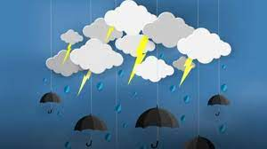
CONTENT
Abstract
Introduction
Problem definition
Existing System
Proposed System
Hardware Requirements
Architecture
Modules
Algorithms
References

Slide 3

ABSTRACT

Slide 4
ABSTRACT
Rainfall prediction plays a crucial role in various sectors including agriculture, water resource management, and disaster preparedness. Traditional methods often rely on historical data and simple statistical techniques, which may not capture the complex relationships governing rainfall patterns. In this presentation, we explore the use of multiple linear regression models to improve rainfall prediction accuracy. Our study focuses on integrating various meteorological parameters such as temperature, humidity, wind speed, and atmospheric pressure, along with geographical factors like elevation and proximity to water bodies. By utilizing multiple linear regression, we aim to uncover the interdependencies among these variables and their impact on rainfall.

Slide 5
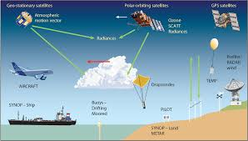
INTRODUCTION

Slide 6
introduction
Enhancing Rainfall Prediction through Multiple Linear Regression Models Rainfall is a fundamental component of Earth's climate system, influencing various aspects of human life and natural ecosystems.
Accurate prediction of rainfall patterns is crucial for agriculture, water resource management, flood mitigation, and disaster preparedness. Traditional methods of rainfall prediction often rely on historical data and simplistic statistical techniques, which may not fully capture the intricate relationships between meteorological variables and precipitation.
In recent years, the advent of machine learning and statistical modeling techniques has opened up new avenues for improving rainfall prediction accuracy. Among these techniques, multiple linear regression stands out as a powerful tool for analyzing the complex interdependencies among various meteorological factors and their impact on rainfall.
Objective of the Presentation In this, we develop into the realm of rainfall prediction using multiple linear regression models. Our primary objective is to explore how this advanced modeling approach can enhance the accuracy and reliability of rainfall forecasts, thereby empowering decision-makers in sectors reliant on weather predictions.

Slide 7
Problem definition

Slide 8
Problem definition
The problem involves enhancing rainfall prediction accuracy by leveraging multiple linear regression models integrating meteorological parameters (temperature, humidity, wind speed, atmospheric pressure) and geographical factors (elevation, proximity to water bodies).
The primary objective is to understand the complex relationships among these variables and their combined influence on rainfall patterns. By developing a robust prediction model, we aim to provide valuable insights for sectors such as agriculture, water resource management, and disaster preparedness, where accurate rainfall forecasts are crucial for decision-making.
Challenges include managing multicollinearity among predictors, ensuring data quality, and interpreting the model's coefficients effectively to extract actionable information for stakeholders. This study aims to contribute to improving rainfall forecasting methodologies, facilitating more informed and effective resource management and planning strategies.

Slide 9
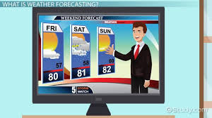
EXISTING SYSTEM

Slide 10
EXISTING SYSTEM
Here are additional existing systems for rainfall prediction:-
Historical Data Analysis:
Many current methods use historical rainfall data and basic statistics to predict future rainfall.
This approach looks at patterns in past rainfall to estimate what might happen next.
Basic Weather Models:
Some systems use simple weather variables like temperature, humidity, and wind speed to make predictions.
However, these models may miss important connections between different factors affecting rainfall.
Traditional Statistical Methods:
Often rely on historical data and basic statistical techniques like moving averages or simple regression models.
Limited by the simplicity of models and the scope of variables considered, which may not capture complex interactions affecting rainfall.

Slide 11
DISADVANTAGES OF EXISTING SYSTEM
Short-Term Focus: Traditional methods are better at predicting short-term weather changes rather than long-term climate trends. They might not capture the bigger picture of how rainfall patterns are shifting over time.
Not Customized: Traditional methods give generalized predictions that might not match what's happening in specific areas. Rainfall can vary a lot from place to place due to differences in terrain, like mountains or cities, which these methods might not take into account.
Not Flexible: These methods assume that the climate will stay the same over time, but we know that climate can change due to global warming and other factors. They struggle to adapt to these changes and can become less accurate as a result.
Sensitive to Weird Events: If something unusual happens, like an extreme storm or drought, these methods might give incorrect predictions because they rely heavily on past data trends and can't handle unexpected events well.

Slide 12
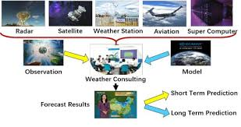
PROPOSED SYSTEM

Slide 13
PROPOSED SYSTEM

Slide 14
ADVANTAGES OF PROPOSED SYSTEM

Slide 15
System : Intel Core i3. Hard Disk : 1TB. Monitor : 15’’ LED Input Devices : Keyboard, Mouse Ram : 8GB.
HARDWARE REQUIREMENTS

Slide 16
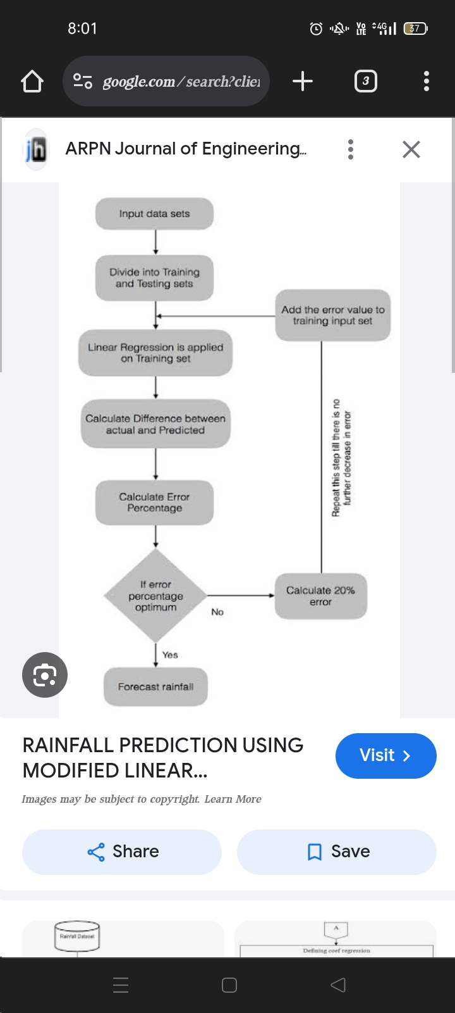
ARCHITECTURE

Slide 17
MODULES

Slide 18
ALGORITHM

Slide 19
REFERENCES

Slide 20
Thank you

